Slide 1
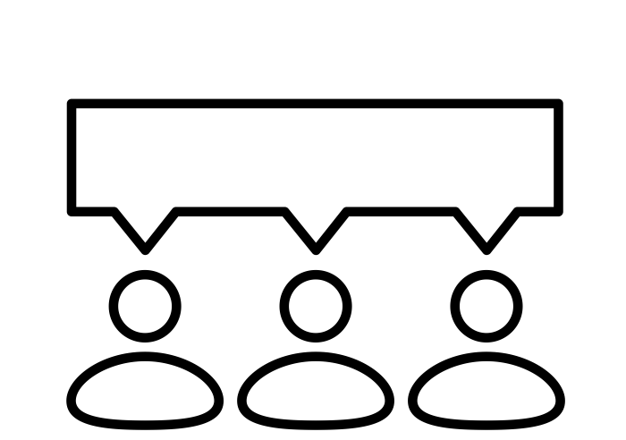
Infrared Camera
Sensing System
Based on Artificial Intelligence
Infrared Camera Sensing System
Based on Artificial Intelligence
First Project
20192 Capstone Design Project 1 - Team7
Copyrightⓒ. Saebyeol Yu. All Rights Reserved.
Notes:
Post processing of data from infrared camera sensing system by using Artificila Intelligence

Slide 2
Contents
001
What is Our Project?
002
What we did?
Previous Work
003
What's the plan?
The things we have to do

Slide 3
001
What is Our Project?
Copyrightⓒ. Saebyeol Yu. All Rights Reserved.

Slide 4

1
001 What is Our Project?
Introduction to Partner Company
JC RADAR Inc.
JC RADAR Inc. is an artificial Intelligence-based radar/thermal-camera specialist.
Main business is industrial radar, medical/health radar, and thermal imaging camera research and manufacturing, sales
Key development Items:
Body’s breathing/Heartbeat measurement radar
Laser Distance/Speed Meter
AI-based radar/thermal-camera
Micro Array Antenna
The pioneer of AI-Based Radar/Camera
Copyrightⓒ. Saebyeol Yu. All Rights Reserved.

Slide 5
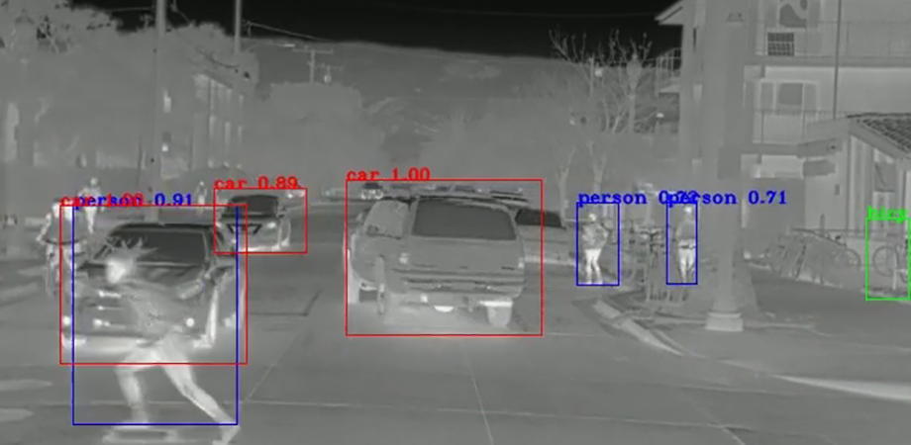
1
001 What is Our Project?
Introduction to Project
Infrared Camera Sensing System
Based on Artificial Intelligence
Object Recognition
Intent Classification
Camera Control
Change Monochrome Photo to Color Photo
Copyrightⓒ. Saebyeol Yu. All Rights Reserved.

Slide 6
002
What we did?
Copyrightⓒ. Saebyeol Yu. All Rights Reserved.

Slide 7
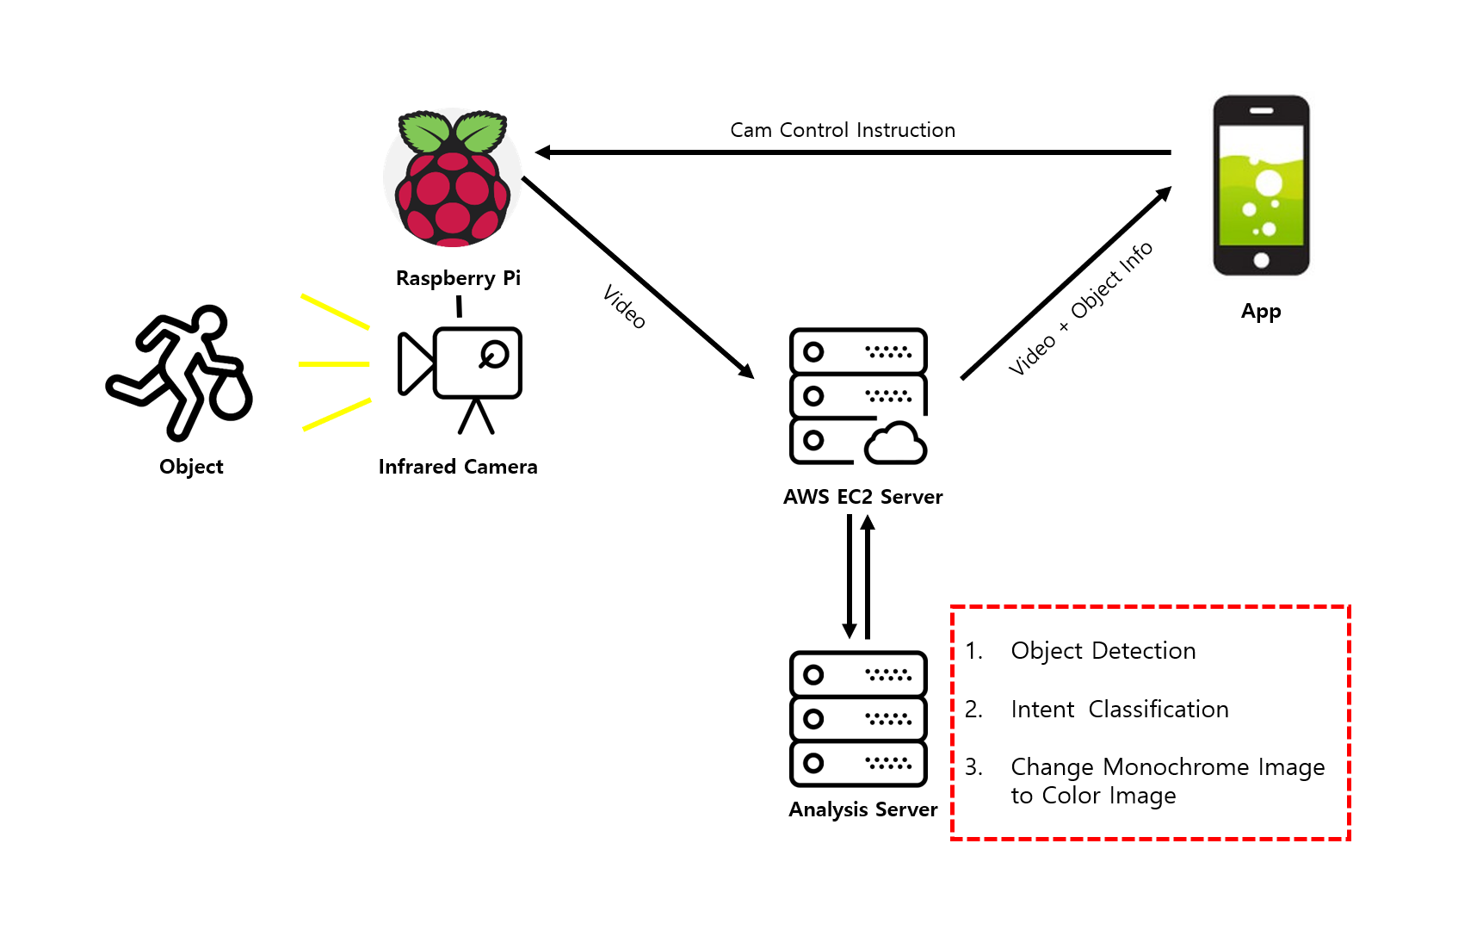
2
002 What we did?
Our Project Overview
Copyrightⓒ. Saebyeol Yu. All Rights Reserved.

Slide 8





2
002 What we did?
Our Project Overview
Video
Video + Object Info
Cam Control Info
Cam Control Info
Raspberry Pi
Analysis Server
Object Detection
Increase Camera Quality
Change Monochrome Image to Color Image
App
Object
Infrared Camera
Copyrightⓒ. Saebyeol Yu. All Rights Reserved.

Slide 9
2
002 What we did?
Our Project Overview
Video
Video + Object Info
Cam Control Info
Cam Control Info
Raspberry Pi
Analysis Server
App
Object
Infrared Camera
Copyrightⓒ. Saebyeol Yu. All Rights Reserved.

Slide 10
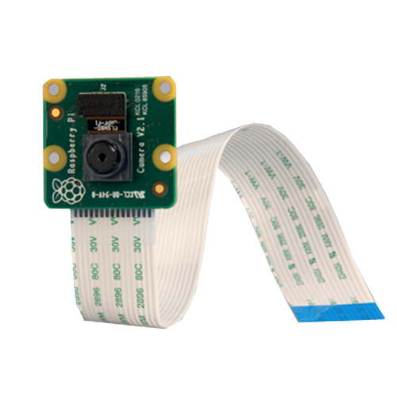
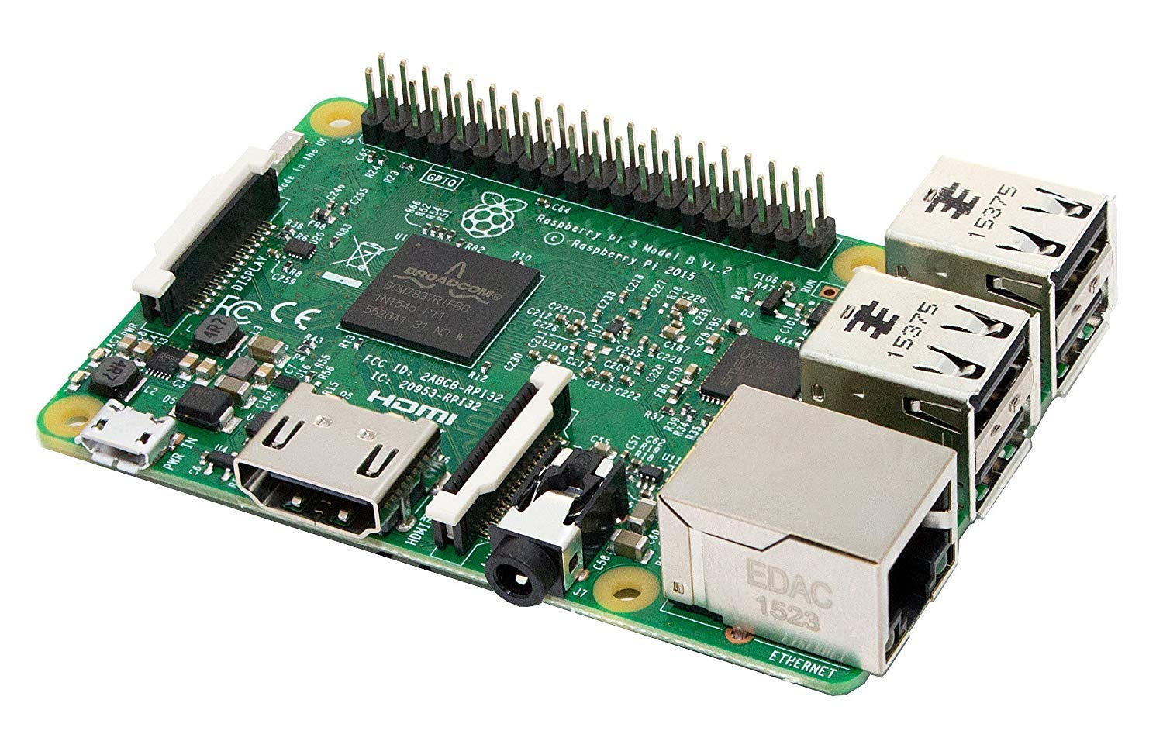
2
002 What we did?
Our Project Overview
Camera of Raspberry PI
Raspberry Pi MotherBoard
Copyrightⓒ. Saebyeol Yu. All Rights Reserved.

Slide 11
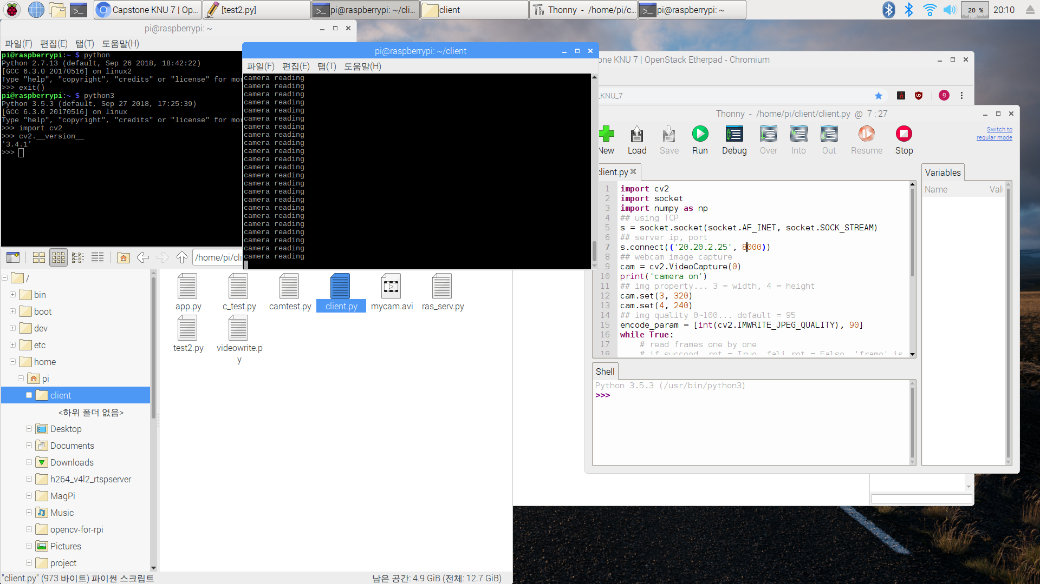
2
002 What we did?
Our Project Overview
Copyrightⓒ. Saebyeol Yu. All Rights Reserved.
Notes:
성공화면

Slide 12
2
002 What we did?
Our Project Overview
Video
Video + Object Info
Cam Control Info
Cam Control Info
Raspberry Pi
Analysis Server
App
Object
Infrared Camera
Copyrightⓒ. Saebyeol Yu. All Rights Reserved.

Slide 13
2
002 What we did?
Our Project Overview
Video
Video + Object Info
Cam Control Info
Cam Control Info
Raspberry Pi
Analysis Server
App
Object
Infrared Camera
Copyrightⓒ. Saebyeol Yu. All Rights Reserved.

Slide 14
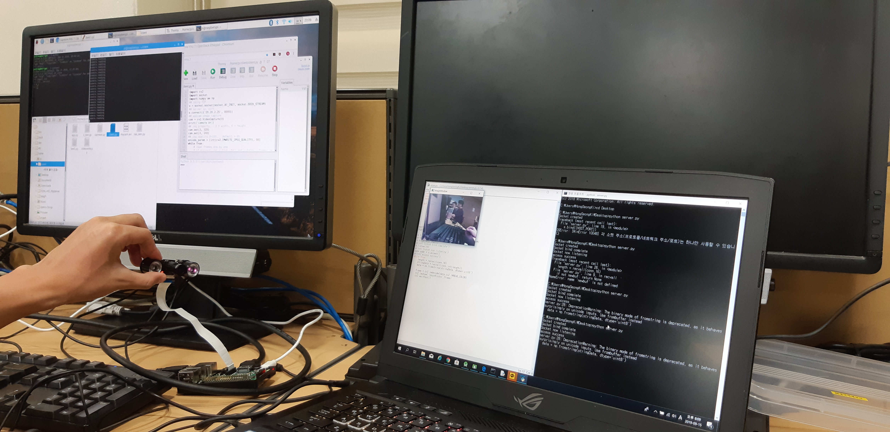
2
002 What we did?
Our Project Overview
Copyrightⓒ. Saebyeol Yu. All Rights Reserved.

Slide 15
2
002 What we did?
Our Project Overview
Video
Video + Object Info
Cam Control Info
Cam Control Info
Raspberry Pi
Analysis Server
App
Object
Infrared Camera
Copyrightⓒ. Saebyeol Yu. All Rights Reserved.

Slide 16
2
002 What we did?
Our Project Overview
Video
Video + Object Info
Cam Control Info
Cam Control Info
Raspberry Pi
Analysis Server
App
How to detect Object??
Object
Infrared Camera
Copyrightⓒ. Saebyeol Yu. All Rights Reserved.

Slide 17
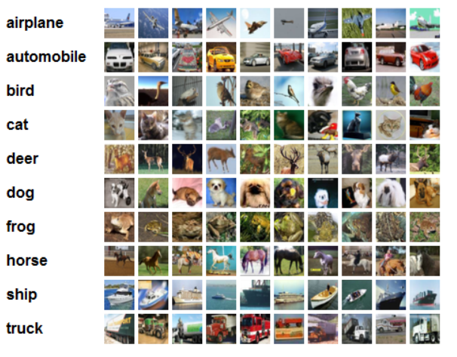
2
002 What we did?
Our Project Overview
CIFAR-10 Dataset
Copyrightⓒ. Saebyeol Yu. All Rights Reserved.
Notes:
문제점 : 고정된 인풋 사이즈가 필요로 하다.

Slide 18
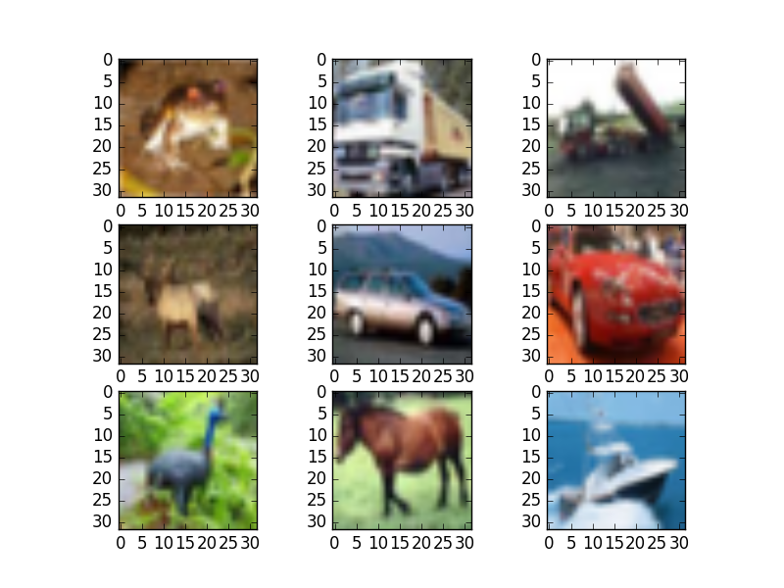
2
002 What we did?
Our Project Overview
Fixed-size image
Copyrightⓒ. Saebyeol Yu. All Rights Reserved.
Notes:
문제점 : 고정된 인풋 사이즈가 필요로 하다.

Slide 19

2
002 What we did?
Our Project Overview
Ojbect Detection
Copyrightⓒ. Saebyeol Yu. All Rights Reserved.

Slide 20

2
002 How's it coming?
Our Project Overview
Copyrightⓒ. Saebyeol Yu. All Rights Reserved.
Notes:
문제점 : 고정된 인풋 사이즈가 필요로 하다.

Slide 21
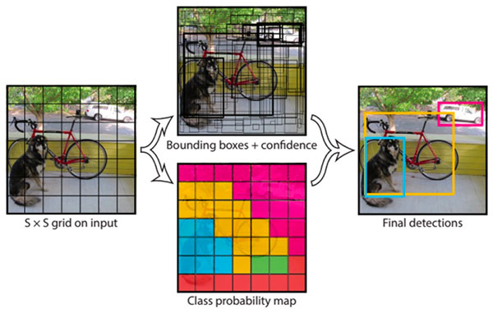
2
002 How's it coming?
Our Project Overview
YOLO - You Only Look Once
Copyrightⓒ. Saebyeol Yu. All Rights Reserved.

Slide 22
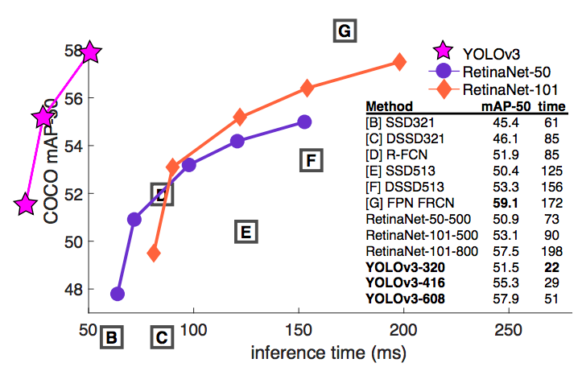
2
002 How's it coming?
Our Project Overview
YOLO – Performance Graph
Copyrightⓒ. Saebyeol Yu. All Rights Reserved.

Slide 23
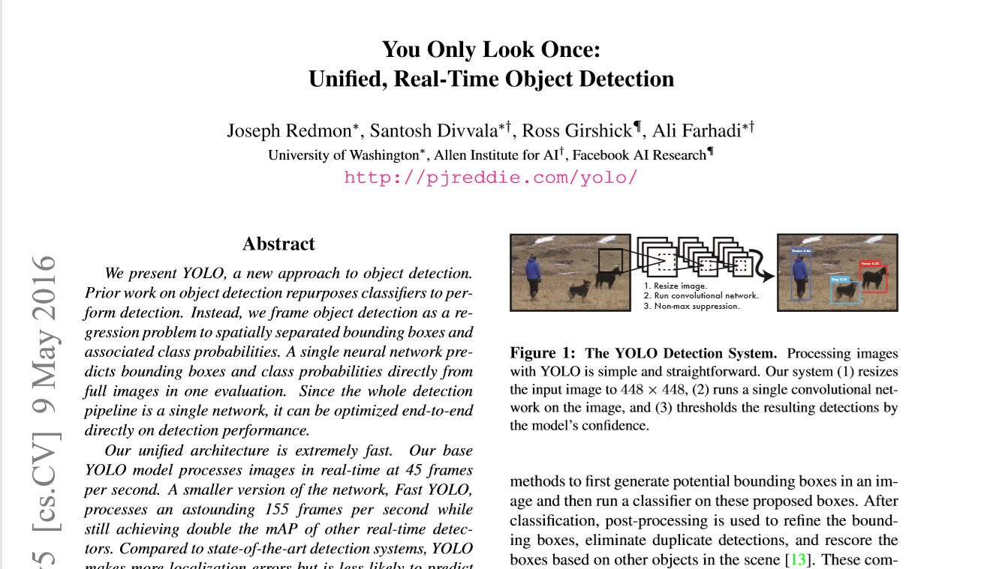
2
002 How's it coming?
Our Project Overview
Copyrightⓒ. Saebyeol Yu. All Rights Reserved.

Slide 24
003
What's the plan?
Copyrightⓒ. Saebyeol Yu. All Rights Reserved.

Slide 25
3
003 What's the plan?
Our future plan - 1
Video
Video + Object Info
Cam Control Info
Cam Control Info
Raspberry Pi
Analysis Server
App
We have to build App or Web Service!
Object
Infrared Camera
Copyrightⓒ. Saebyeol Yu. All Rights Reserved.

Slide 26
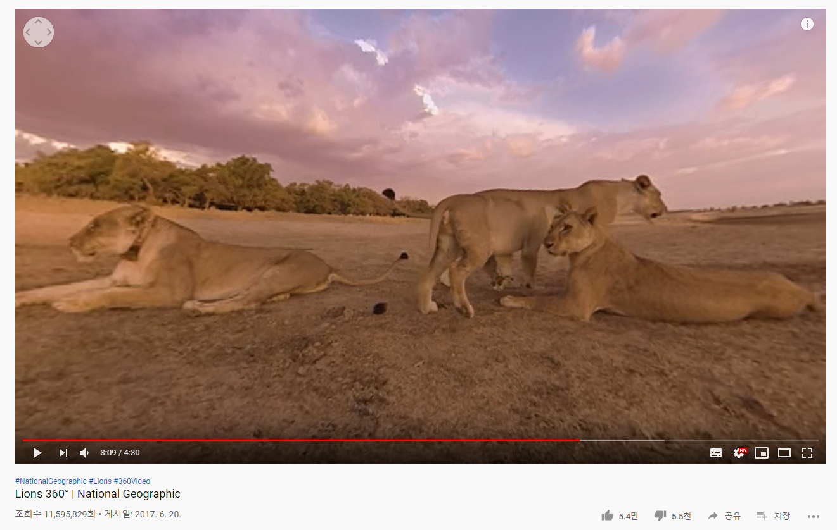
3
003 What's the plan?
Our future plan - 2
Copyrightⓒ. Saebyeol Yu. All Rights Reserved.

Slide 27
3
003 What's the plan?
Our future plan - 2
Video
Video + Object Info
Cam Control Info
Cam Control Info
Raspberry Pi
Analysis Server
App
Object
Infrared Camera
Copyrightⓒ. Saebyeol Yu. All Rights Reserved.

Slide 28
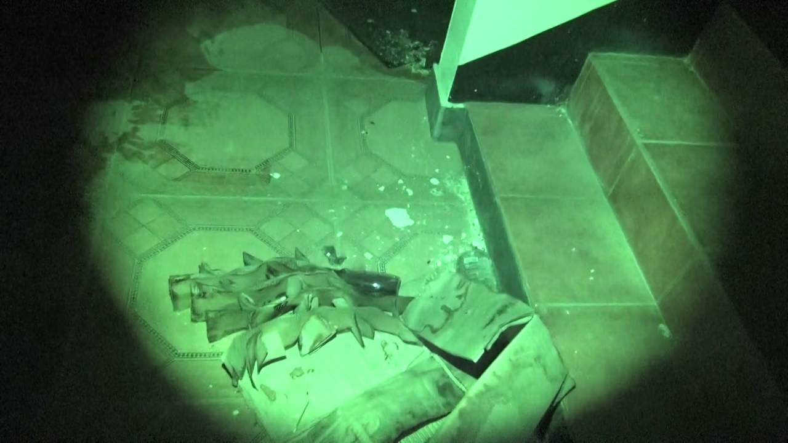
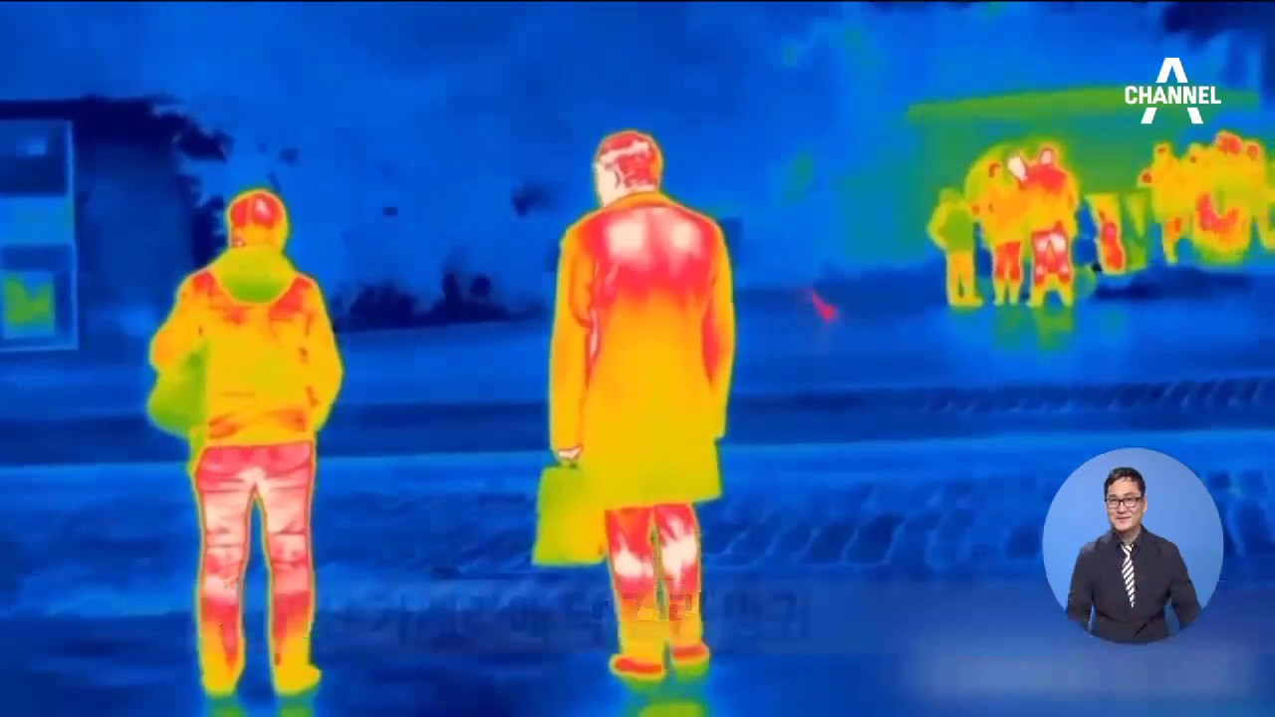
3
003 How to develop?
Our future plan - 3
Infrared Image
Thermal Imaging
Notes:
Animal Detect → Animal Detection

Slide 29
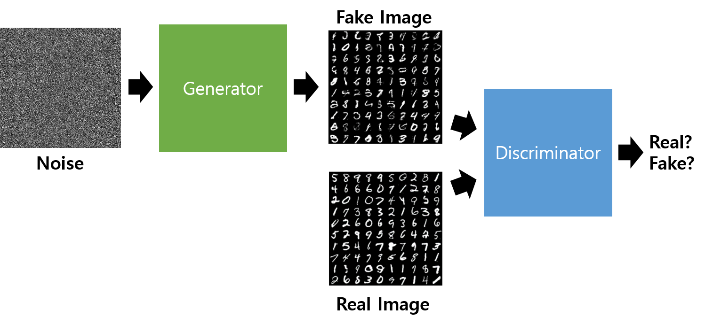
3
003 How to develop?
Our future plan - 3
Generative Adversarial Networks
Notes:
Animal Detect → Animal Detection

Slide 30
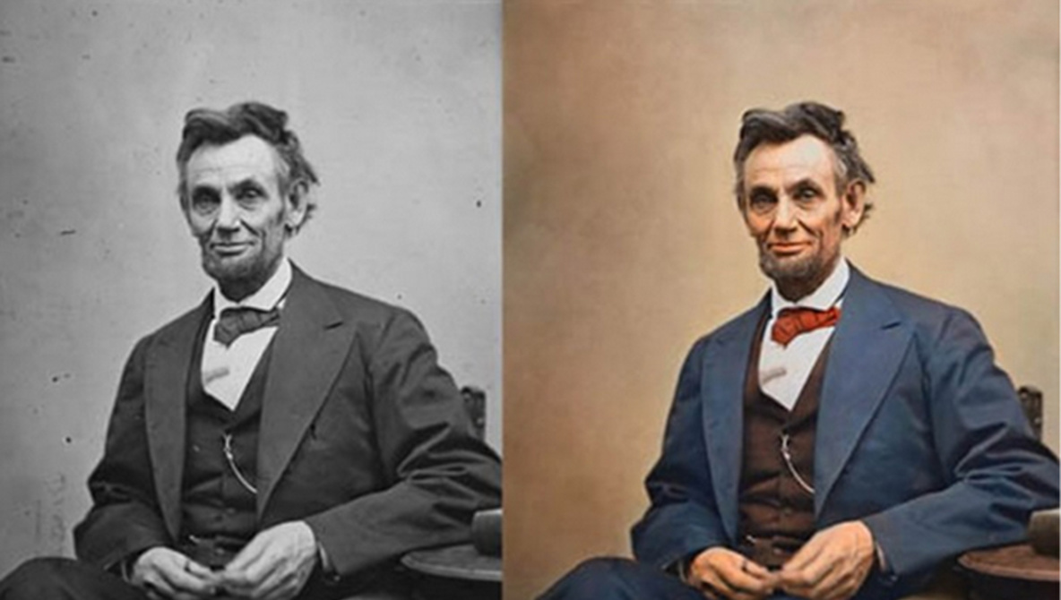
3
003 How to develop?
Our future plan - 3
Image Colorization
Notes:
Animal Detect → Animal Detection

Slide 31
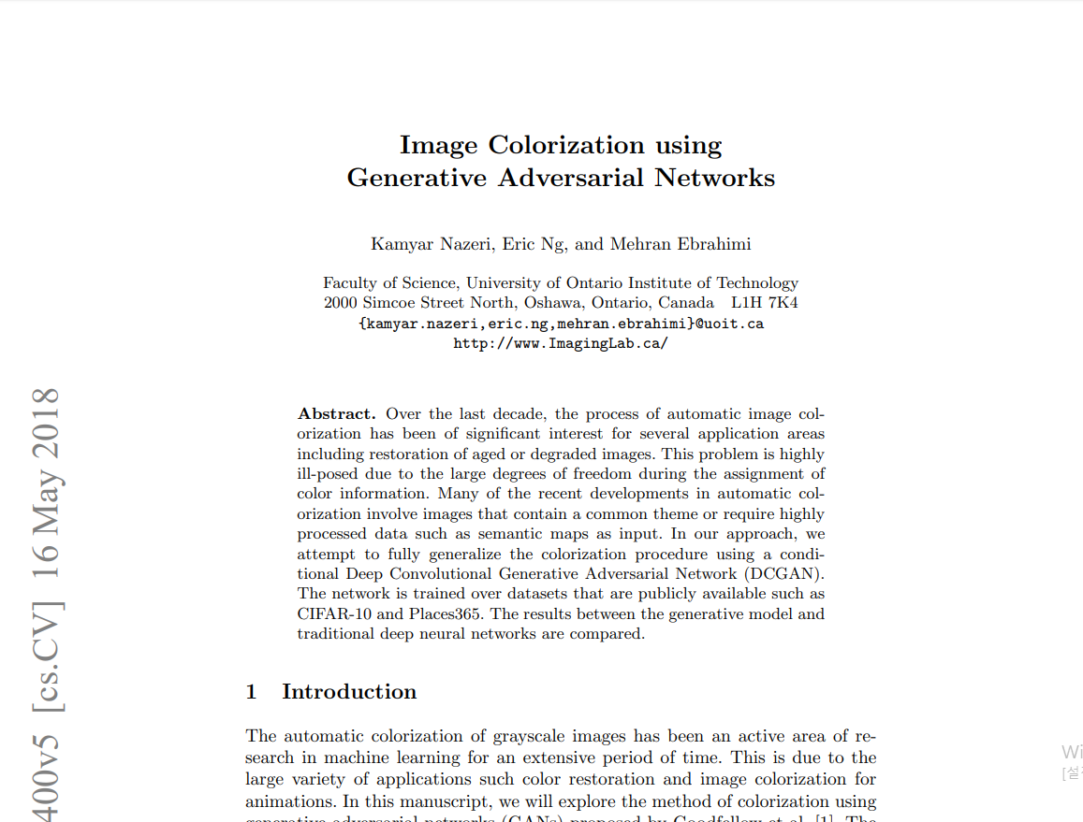
3
003 How to develop?
Our future plan - 3
Notes:
Animal Detect → Animal Detection

Slide 32
3
004 When is It finished?
Our Schedule
September
Planning
Analysis
Design
Implement
October
Implement
Patent
Thesis
November
Patent
Thesis
Announcement

Slide 33
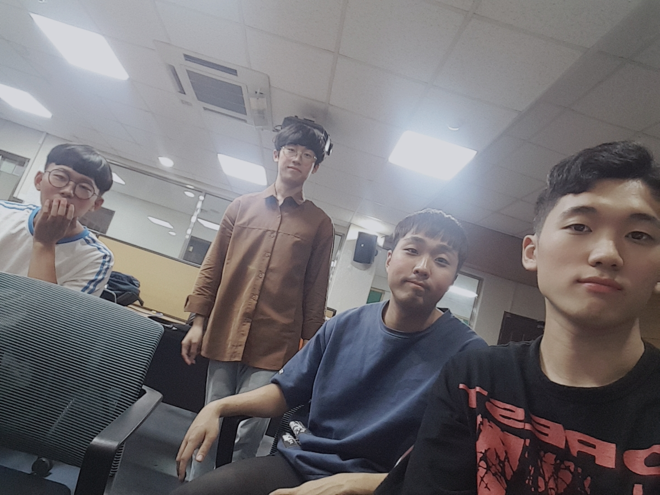
4
004 When is It finished?
Our Meeting
2019. 09. 15 | Third Meeting
Problem Recognition
Analysis
Development
Kyungpook National University, Daegu
Notes:
Identify Company Requirements -> Identify Business Requirements (민철)

Slide 34
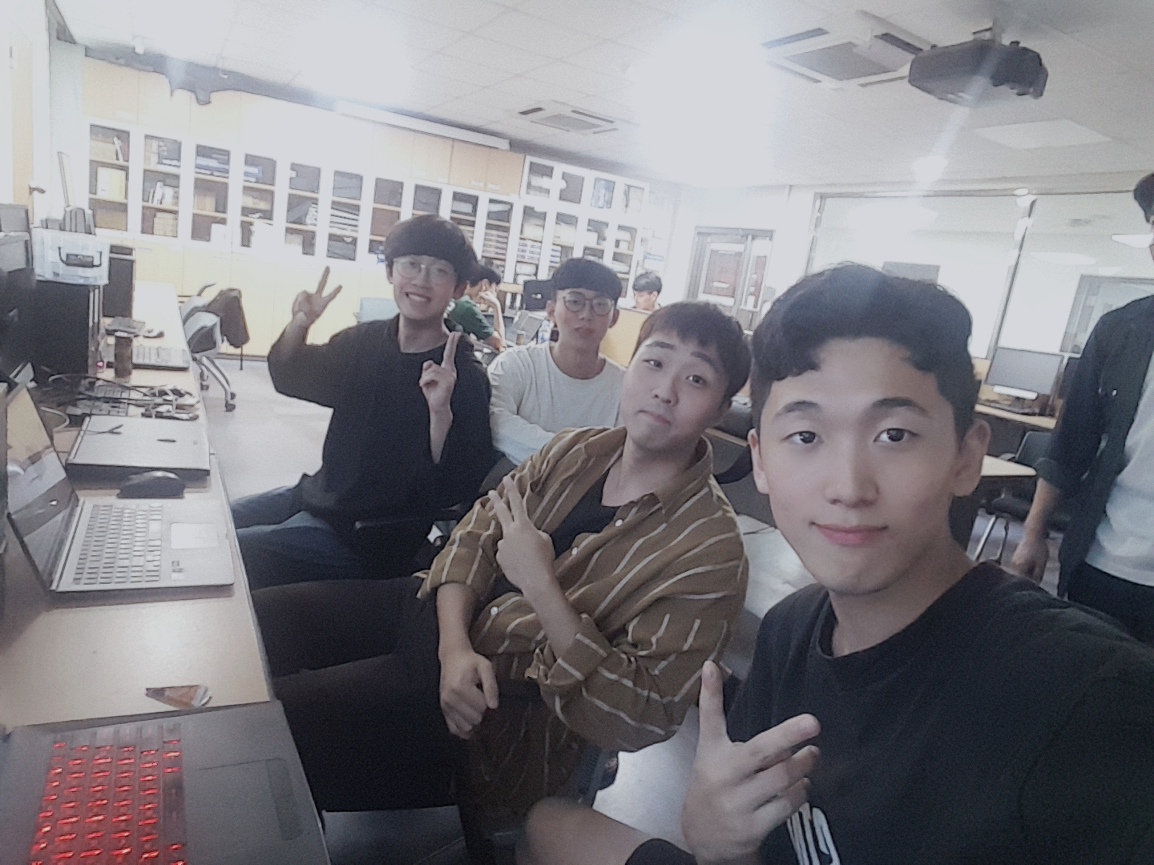
4
004 When is It finished?
Our Meeting
2019. 09. 16 | Fourth Meeting
Problem Recognition
Analysis
Development
Kyungpook National University, Daegu
Notes:
Identify Company Requirements -> Identify Business Requirements (민철)

Slide 35

Thank You.
Copyrightⓒ. Saebyeol Yu. All Rights Reserved.

